Slide 1
World Happiness Report Analysis using Plotly

Slide 2
Overview of the Dataset
Analysis carried out with the World Happiness Report database.
In the dataset you will find country-specific happiness indicators.
Combines qualitative, ordinal and quantitative data.
All publication-ready visualizations were created using Plotly.
To identify factors that affect happiness in the world.
Notes:
This is the analysis of World happiness report data with interactive visualization with Plotly. Some of the dimensions of the data set are happiness score, GDP per capita, social support, healthy life expectancy, freedom to make life choices, generosity, and perceptions of corruption. These factors are likely to account for some of the differences in happiness rankings between different countries. The analysis aims at identifying meaningful links between the indicators of economic, social and health and happiness. All visualizations are created with colour-blind friendly colour schemes and publication quality formatting to make them accessible, readable and professional (Wu et al., 2025).

Slide 3
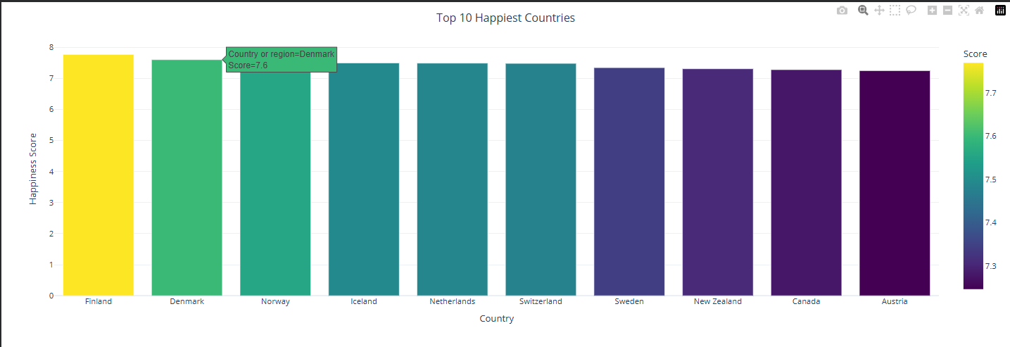
Top Happiest Countries
Finland is the most happy country in the world.
The top countries are the Nordic countries.
A score of above 7.4 is consistently present for happiness.
Well-developed social systems play an important role.
GDP is not sufficient to account for rankings.
Notes:
The bar chart shows the 10 happiest nations in the world. These are followed by Denmark, Norway and Iceland, with Finland at the top. These countries are always in the top list of countries around the world, as they have strong economic development, high social support, healthcare, and public trust. The graph shows that although a person's GDP affects happiness, it is not the only factor. The countries, which have effective government and high social welfare rate become excellent. The findings highlight the importance of various facets of happiness, and not only economic wealth, so that this is a multi-faceted analytical issue (Wu et al., 2025).

Slide 4
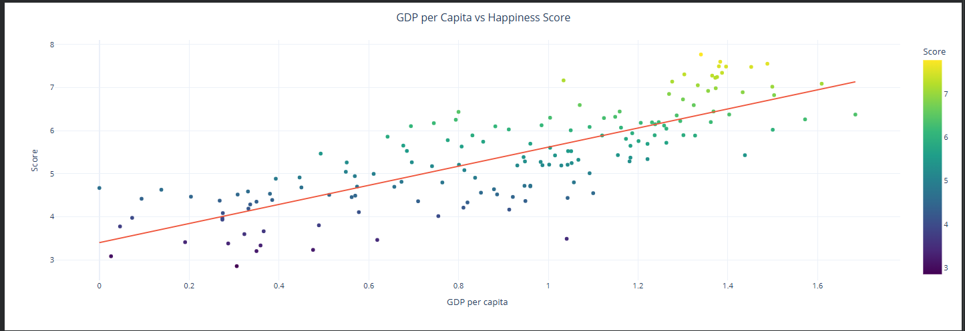
GDP vs Happiness
There is positive correlation between GDP and happiness.
Generally happier countries are those with a higher rate of wealth.
Even countries with moderate GDP will outperform some.
Trendline indicates a positive correlation.
While GDP is important, it is not enough.
Notes:
This scatter graph looks at the correlation between GDP per capita and happiness score. The positive sloping trend line shows that higher income levels tend to be associated with higher levels of happiness in countries. But there are some countries that have high happiness values, even though they do have moderate GDP values, suggesting that there are other factors that affect happiness. Economic growth is the source of resources to fund other services and institutions, such as healthcare and education, but it is not enough to ensure happiness. The visualization helps to strengthen the linkage between financial performance and social and institutional development. In this regard, policy makers need to turn their attention towards balance development strategies and not just economic indicators (Yousfi, Chiadmi and Rhanoui, 2022).

Slide 5
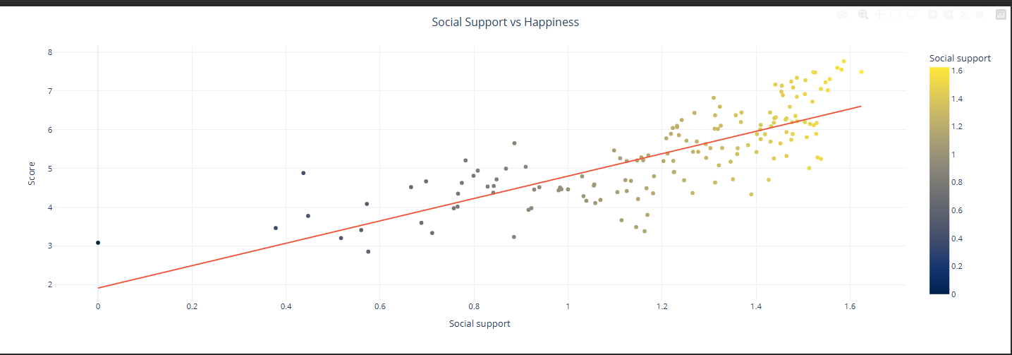
Social Support & Health
There's a strong correlation between social support and happiness.
A healthy life expectancy contributes to good quality of life.
The countries, which have a better healthcare system, have a higher score.
Happy people live in happy communities.
Health and relationships go hand-in-hand with economic growth.
Notes:
This slide is the combination of two key determinants of happiness: social support and health life expectancy. There is a strong positive correlation between both variables with the happiness scores. Countries that offer social supports such as families, friends, and communities have higher levels of life satisfaction. Likewise, a healthier society lives longer and has more productive lives, directly impacting happiness. The results point out that governments should invest in building community as well as economic development, and in health systems. The combination of these indicators accounts for a large share of the happiness country differences (Yousfi, Chiadmi and Rhanoui, 2022).

Slide 6
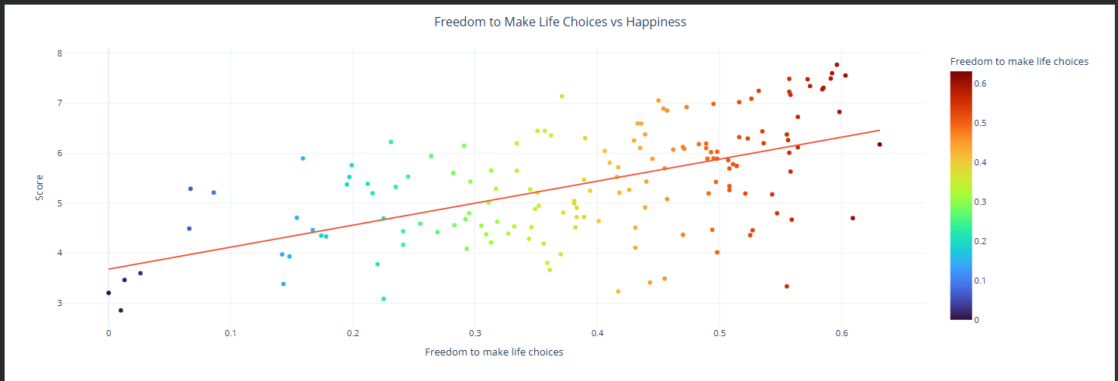
Freedom, Generosity & Corruption
The more free one is, the happier they are.
Generosity contributes positively.
Low corruption leads to greater public confidence.
In freedom, people can make better decisions in their lives.
Well-being is supported by ethical governance.
Notes:
Another factor that brings happiness is having the freedom to make personal decisions. In societies with more individual autonomy, there is higher satisfaction with life. Generosity also has a positive influence, but at a comparatively lower magnitude than GDP and social support. Conversely, individuals who have a negative perception of corruption also show a greater level of trust and confidence in institutions. All of these factors show that governance quality and social values have a considerable impact on national happiness. However, as well as economic development, improving transparency, encouraging civic involvement and safeguarding individual freedoms can improve citizens' lives (Kumar et al., 2022).

Slide 7
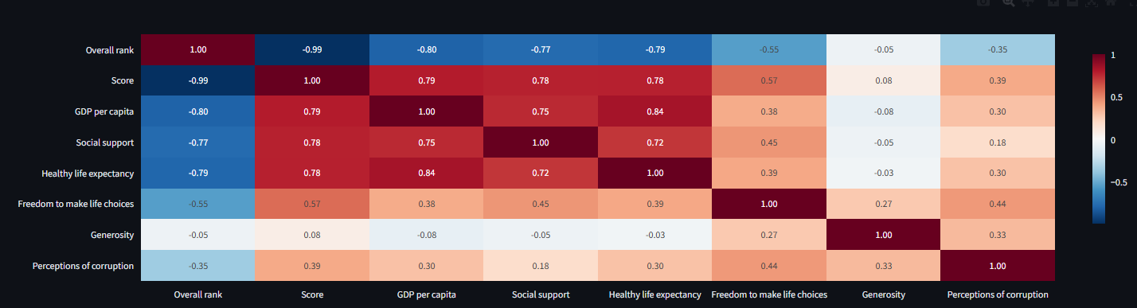
Correlation Analysis
The strongest correlation is that with GDP.
Social support is a strong factor.
Among the factors that are highlighted is healthy life expectancy.
The correlation with Generosity is weaker.
Correlation indicates significant predictors.
Notes:
The correlation analysis examines the strength of the relationship between each of the numerical variables and happiness score. The strongest positive correlations are with GDP per capita, social support and healthy life expectancy which are the key determinants of national happiness. Freedom makes a strong contribution and generosity has a relatively low association. Correlation is not cause and effect, but it indicates which variables should be explored further. This visualization helps policy makers and researchers identify the most promising investments for enhancing overall human happiness and citizen well-being (Kumar et al., 2022).

Slide 8
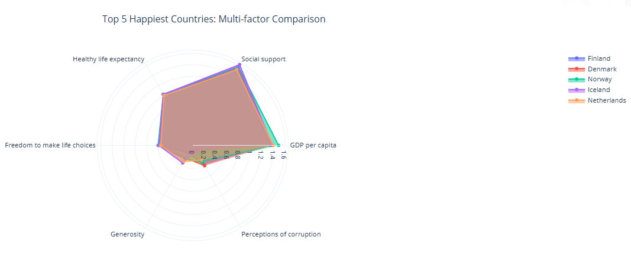
Distribution & Radar Comparison
Happiness scores are approximately normally distributed.
The majority of countries are in the middle band.
Best countries are good on most indicators.
Radar chart allows for multiple comparisons.
Balanced performance equals better ranking.
Notes:
The histogram shows the distribution of happiness scores across all countries and shows that most countries are in a range of happiness in between the highest and lowest scores, with relatively few countries being in the higher or lower extreme. The radar chart provides a visual comparison of the top countries in each of the indicators. Finland, Denmark, Norway and Iceland show consistently high levels of GDP, health, social support and freedom, indicating that a balance of development leads to greater happiness. These countries don't do one thing exceptionally well, but rather perform well in a number of areas. This is a multidimensional comparison which stresses the complexity of measuring and enhancing national well-being (Bingham, 2023).

Slide 9
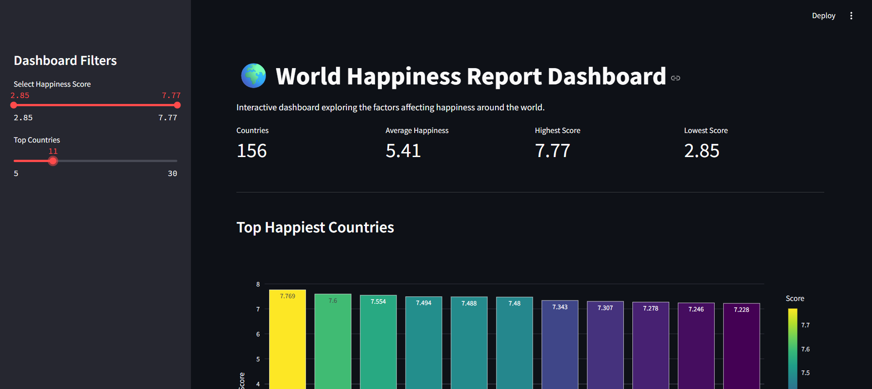
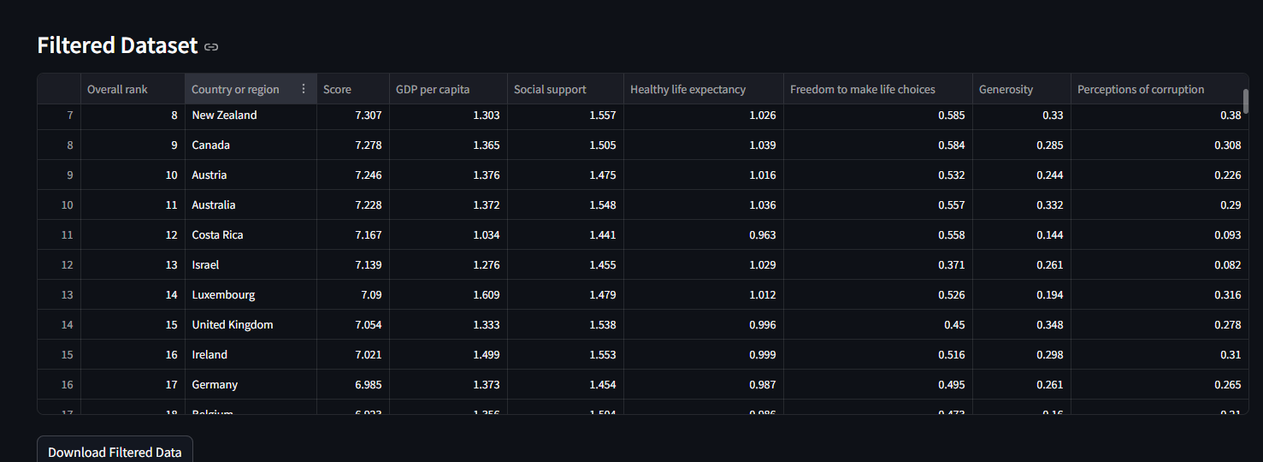
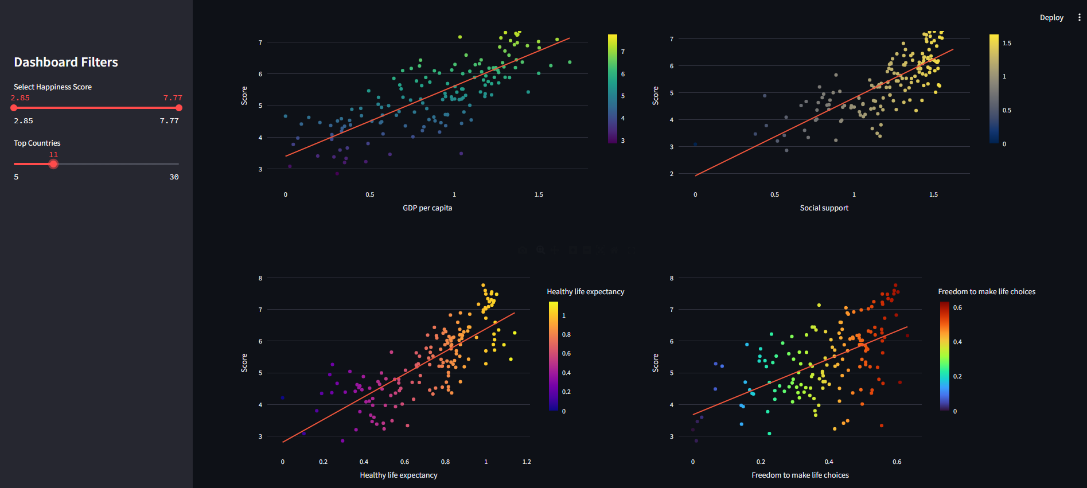
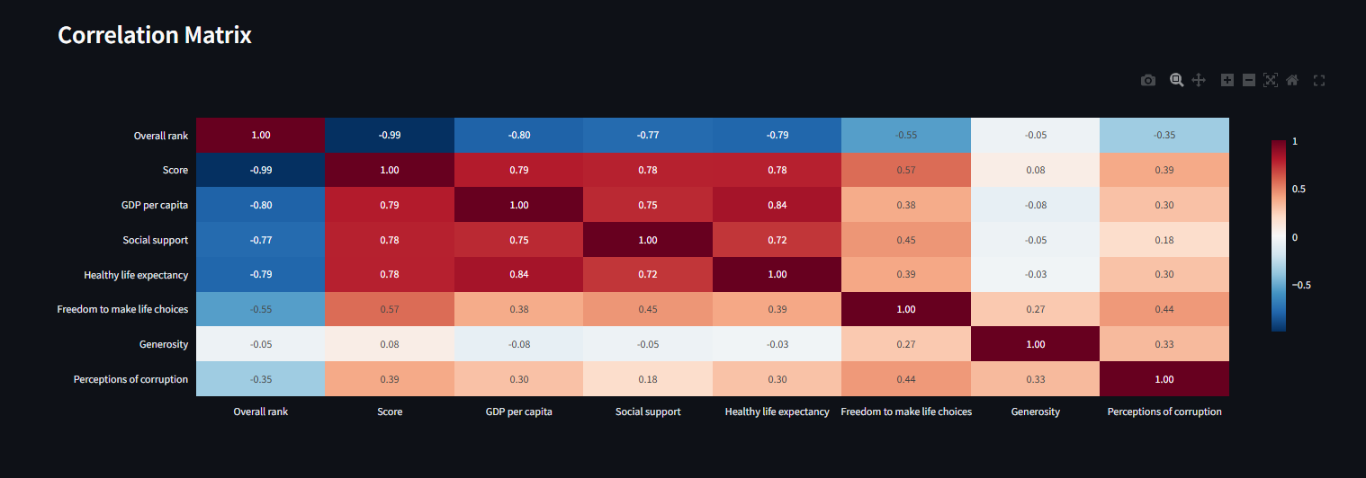
Streamlit Dashboard for World Happiness Analysis
http://localhost:8502/
Notes:
You can now view your Streamlit app in your browser.
Local URL: http://localhost:8502
Network URL: http://192.168.1.4:8502 The Streamlit dashboard renders this static data analysis as a live web-app that allows users to interact with the World Happiness Report. It offers a user-friendly interface and sidebar filters for the displays of happiness score and the number of top-ranked countries. Graphs are interactive and use Plotly to zoom, pan and display data points with hover information, and KPIs provide a concise summary of key metrics. There's also a downloadable filtered data set that can be used for additional (Bingham, 2023)

Slide 10
Conclusions & Future Work
There are several factors that contribute to happiness—all of which are interrelated.
National well-being cannot be measured only in terms of GDP.
Social supports and health are essential.
The moral administration, increases the joy.
Regional and temporal analysis can be done in future studies.

Slide 11
References
Bingham, A.J. (2023). From data management to actionable findings: A five-phase process of qualitative data analysis. International Journal of Qualitative Methods, [online] 22(22), pp.1–11. doi:https://doi.org/10.1177/16094069231183620.
Kumar, S., Sharma, D., Rao, S., Lim, W.M. and Mangla, S.K. (2022). Past, present, and future of sustainable finance: Insights from big data analytics through machine learning of scholarly research. Annals of Operations Research, 345. doi:10.1007/s10479-021-04410-8.
Wu, S., Luan, W., Wang, Y., Zeng, D., Shen, Q. and Tang, B. (2025). Data Insights as Data: Quick Overview and Exploration of Automated Data Insights. arXiv.org. [online] doi:10.1145/3706599.3719702.
Yousfi, S., Chiadmi, D. and Rhanoui, M. (2022). Smart big data framework for insight discovery. Journal of King Saud University - Computer and Information Sciences. doi:10.1016/j.jksuci.2021.12.009.

